Slide 1
Managing Customer Churn
Austė Maštavičiūtė

Slide 2
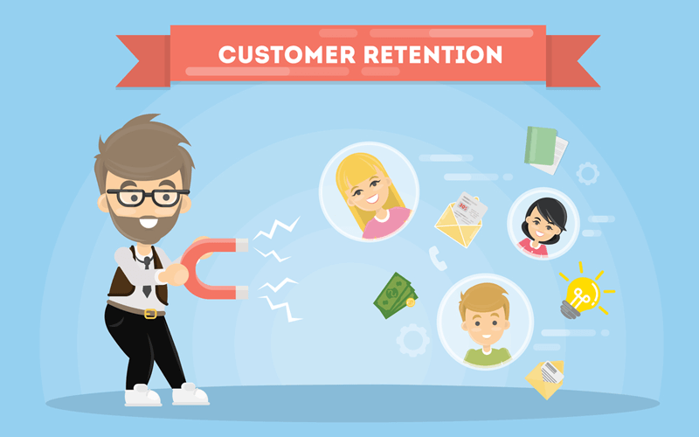

Retention vs Sales
Sales
Notes:
Customer Retention is so much easier than doing new sales, so why don’t companies focus on that part of the business?

Slide 3





Customer Retention Challenges
Gigantic Amounts of Data
TIMELY Access to Review Data
Sentiment Analysis and Interpretation
Categorizing Reviews
Taking Proactive Action

Slide 4

Approach
14,885 Tweets about Airlines
TextBlob & Vader
Count Vectorizer
Non-negative Matrix Factorization (NMF)
KMeans
t-Distributed Stochastic Neighbor Embedding (t-SNE)

Slide 5
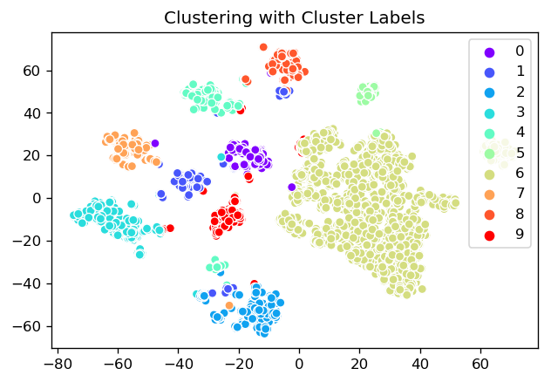
Clustering

Slide 6
Not Too Shabby...
TWEET
SUGGESTION
@AmericanAir thank you so much that helps a lot
Keep up the good work! 👍
@United I have never had such a horrible customer service
Please Improve Customer Service Rep Training 😞
@united and most frustratingly, all this delay happened either at the gate, or even onboard the aircraft! No heads up in advance!!!
Please Improve Your Scheduling 🕓
@USAirways but my bag is still missing
Please Pay More Attention at Baggage Handling 👜

Slide 7
Could be better...
TWEET
SUGGESTION
@united Making sure your flights aren't delayed due to poor maintenance would be a start.
Keep up the good work! 👍
@AmericanAir Worst airline. You Cancelled Flight flight, don't let me know, I waited on hold 30 mins, told to callback at middle of the night?!!
Weather Is Out of Your Control, Relax 💨
@AmericanAir don't they already know ? Isn't everyone sharing how nasty the food is? It's not even close to decent
Please Improve Your Rebooking Process 🎫

Slide 8
Next Steps
Further Tweet Analysis
Improve Spelling
More Data
Neural Network

Slide 9
Thank You

